Slide 1
A11Y aria usage Angular 8
Aria-pressed for buttons
Gopi Kema
Date 08/04/2019

Slide 2
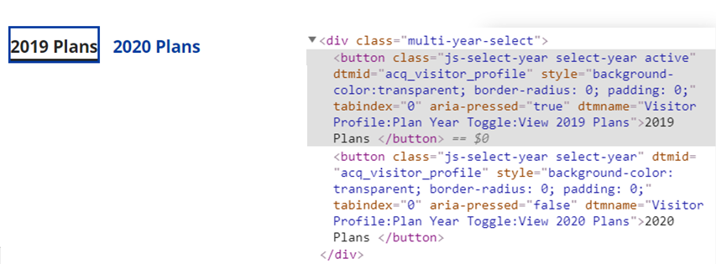
Year plan buttons need aria-pressed
Example: Visitor profile- year plans using native html <button>
Keyboard interaction for buttons: use tab key to navigate to each button and use space or enter for selection
WAI-ARIA needed: aria-pressed=“true/false”
Angular 8 to manage value: [attr.aria-pressed]="appData.activeYear === currentYear"

Slide 3
Use Angular to set “true” or “false”
<div class="multi-year-select" *ngIf="isAEPPeriod()">
<button [attr.aria-pressed]="appData.activeYear === currentYear" [attr.dtmname]="'Visitor Profile:Plan Year Toggle:View ' + currentYear + ' Plans'" class="js-select-year select-year" [class.active]="appData.activeYear === currentYear" (click)="getPlanYearData(currentYear)">{{profilePage.currentyearTab}}</button>
<button [attr.aria-pressed]="appData.activeYear === (currentYear+1)" [attr.dtmname]="'Visitor Profile:Plan Year Toggle:View ' + (currentYear+1)+ ' Plans'" class="js-select-year select-year" [class.active]="appData.activeYear === (currentYear+1)" (click)="getPlanYearData(currentYear+1)">{{profilePage.nextyearTab}}</button>
</div>
Source URL: https://angular.io/guide/accessibility

Slide 4
Thank you

